Slide 1
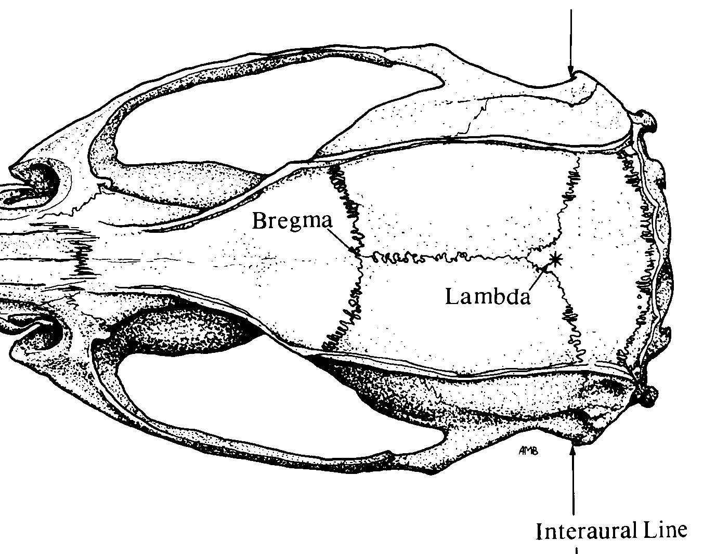

Optrode Pinnacle 3-Channel layout
Implant Map
Pin-out
1 GND | 2 EEG-Ch2 (L-M1) | 3 EEG3 (optrode R-M1)
4 COMM | 5 EEG-Ch1 (EMG) | 6 EEG3 (optrode R-M1)
White out
*
*
2
❸ ❻
Bregma
Stereotaxic Coordinates
Location | Bregma | Midline
M1 | +1.5 (anterior) | ±2.0 (lateral)
EMG | Nuchal musc
Lambda
❹
❶
5
Nuchal muscle
*
Anchor screw
Adjust ratio $=\frac{Measured X B−L}{Reference X B−L}$

